Slide 1

Abusing MSSQL Part II

Slide 2

#whoami
👉 Chirag Savla
👉 Twitter – @chiragsavla94
👉 Interest area – Red Teaming, Application Security, Penetration Testing
Blog – https://3xpl01tc0d3r.blogspot.com

Slide 3
Success is all about persistence and doing the right thing for the long term.
— Bruce Rauner

Slide 4
Agenda
Attack Kill Chain
About Persistence
Persistence Techniques
Persistence Leveraging MSSQL
Approach to Detect Persistence

Slide 5
Question
Which Team do you belong to ?
Blue team (The Defenders)
Red team ( The Offensive Side)
Management / Executive
Others

Slide 6
Attack Kill Chain

Slide 7
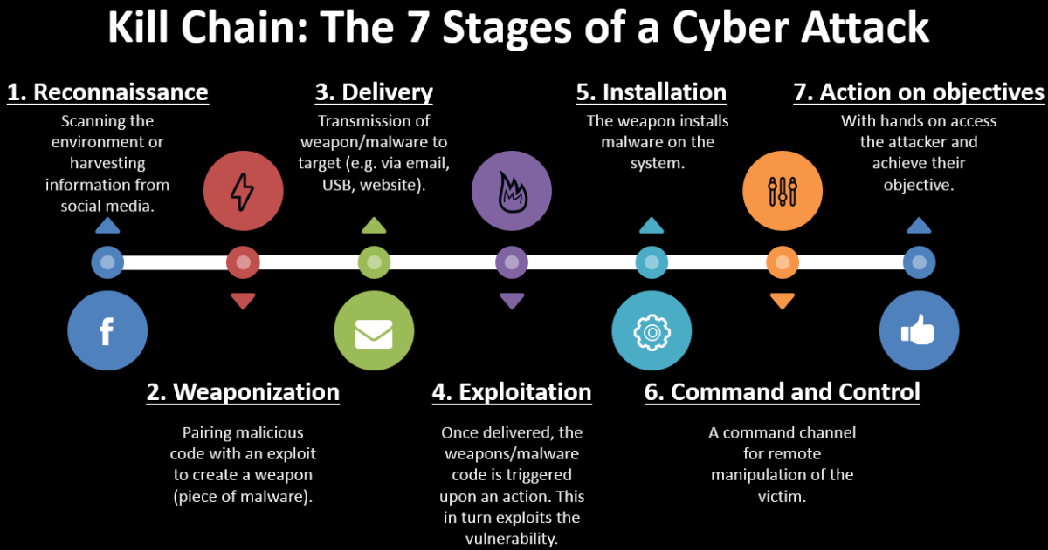
Attack Kill Chain

Slide 8
About Persistence

Slide 9
About Persistence
Persistence is any access, action, or configuration change to a system that gives an adversary a persistent presence on that system.
Adversaries will often need to maintain access to systems through interruptions such as system restarts, loss of credentials, or other failures that would require a remote access tool to restart or alternate backdoor for them to regain access.

Slide 10
Question
Do you think Antivirus (AV) solutions are enough to detect persistent malwares?
Yes, I have a next-gen AV
No
Don’t know

Slide 11
Persistence Techniques

Slide 12
Persistence Techniques
Schedule Task
Registry Run Keys
Startup Folders
DLL Search Order Hijacking
COM Hijacking
Image File Execution Options Injection
Logon Scripts
Windows Management Instrumentation Event Subscription
Account Manipulation
Account Creation

Slide 13
Persistence Leveraging MSSQL
What & Why MSSQL ?
Persistence Opportunities

Slide 14
What & Why MSSQL ?
Microsoft SQL Server is a relational database management system developed by Microsoft. As a database server, it is a software product with the primary function of storing and retrieving data as requested by other software applications — which may run either on the same computer or on another computer across a network.
SQL server mostly runs with privilege accounts which are useful for persistence.

Slide 15
Persistence Opportunities
Startup Stored Procedures - Stored procedures marked for automatic execution are executed every time SQL Server starts. Its automatically executes with the same permissions as members of the sysadmin.
Triggers - A trigger is a special type of stored procedure that automatically runs when an event occurs in the database server. There are 3 types of triggers DML, DDL and Logon.
Registry Keys - Undocumented extended procedures allows sysadmins to read and write the registry keys.

Slide 16
Demo Time
This is not rocket science.

Slide 17
Approach to Detect Persistence
Enable auditing & logging
Tips for detecting persistence

Slide 18
Create and enable SERVER AUDIT
-- Select master database
USE master
-- Setup server audit to log to application log for startup procedures
CREATE SERVER AUDIT Audit_StartUp_Procs
TO APPLICATION_LOG
WITH (QUEUE_DELAY = 1000, ON_FAILURE = CONTINUE)
ALTER SERVER AUDIT Audit_StartUp_Procs
WITH (STATE = ON)
-- Setup server audit to log to application log for startup procedures for triggers
CREATE SERVER AUDIT Audit_Object_Changes
TO APPLICATION_LOG
WITH (QUEUE_DELAY = 1000, ON_FAILURE = CONTINUE)
ALTER SERVER AUDIT Audit_Object_Changes
WITH (STATE = ON)

Slide 19
Create an enabled SERVER AUDIT SPECIFICATION
-- Create server audit specification for startup procedures
CREATE SERVER AUDIT SPECIFICATION Audit_StartUp_Procs_Server_Spec
FOR SERVER AUDIT Audit_StartUp_Procs
ADD (SERVER_ROLE_MEMBER_CHANGE_GROUP),
ADD (SERVER_OPERATION_GROUP),
ADD (AUDIT_CHANGE_GROUP)
WITH (STATE = ON)
-- Create server audit specification for triggers
CREATE SERVER AUDIT SPECIFICATION Audit_Server_Level_Object_Changes
FOR SERVER AUDIT Audit_Object_Changes
ADD (SERVER_OBJECT_CHANGE_GROUP),
ADD (SERVER_OBJECT_PERMISSION_CHANGE_GROUP),
ADD (SERVER_PERMISSION_CHANGE_GROUP),
ADD (SERVER_PRINCIPAL_IMPERSONATION_GROUP)
WITH (STATE = ON)

Slide 20
Create an enabled DATABASE AUDIT SPECIFICATION
-- Create the database audit specification for startup procedure
CREATE DATABASE AUDIT SPECIFICATION Audit_StartUp_Procs_Database_Spec
FOR SERVER AUDIT Audit_StartUp_Procs
ADD (EXECUTE
ON master..sp_procoption BY public )
WITH (STATE = ON)
GO
-- Create the database audit specification for triggers
CREATE DATABASE AUDIT SPECIFICATION Audit_Database_Level_Object_Changes
FOR SERVER AUDIT Audit_Object_Changes
ADD (DATABASE_OBJECT_CHANGE_GROUP)
WITH (STATE = ON)
GO

Slide 21
Demo Time
This is not rocket science.

Slide 22
Tips for detecting persistence
Monitor Registry Changes – Sysmon Event ID 12,13,14
Monitor Account Creation – Event ID 4720
Monitor File Creations – Sysmon Event ID 11
Monitor DLL loading – Sysmon Event ID 7 (ImageLoaded)
Monitor Schedule Task – Event ID 4698
MSSQL – Event ID 33205, 15457,17135

Slide 23
Question
How many of you are already monitoring these events?
All of them
Some of them
Haven't started yet

Slide 24
Credits
Thanks to Null Mumbai for granting me the privilege to present.
Special thanks to Scott Sutherland for documenting the amazing ways to get persistence using MSSQL.

Slide 25
Reference
https://blog.netspi.com/sql-server-persistence-part-1-startup-stored-procedures/
https://blog.netspi.com/maintaining-persistence-via-sql-server-part-2-triggers/
https://blog.netspi.com/establishing-registry-persistence-via-sql-server-powerupsql/
https://attack.mitre.org/tactics/TA0003/
https://uncoder.io/
https://docs.microsoft.com/en-us/previous-versions/sql/sql-server-2008-r2/ms191129(v=sql.105)
https://docs.microsoft.com/en-us/sql/relational-databases/system-stored-procedures/sp-procoption-transact-sql?view=sql-server-2017
https://docs.microsoft.com/en-us/sql/t-sql/statements/create-trigger-transact-sql?view=sql-server-2017
https://docs.microsoft.com/en-us/sql/relational-databases/triggers/implement-ddl-triggers?view=sql-server-2017
https://docs.microsoft.com/en-us/sql/relational-databases/triggers/ddl-event-groups?view=sql-server-2017
https://docs.microsoft.com/en-us/sql/relational-databases/triggers/create-dml-triggers?view=sql-server-2017
https://docs.microsoft.com/en-us/sql/relational-databases/triggers/logon-triggers?view=sql-server-2017
https://support.microsoft.com/en-us/help/887165/bug-you-may-receive-an-access-is-denied-error-message-when-a-query-cal
https://docs.microsoft.com/en-us/sysinternals/downloads/sysmon
https://docs.microsoft.com/en-us/previous-versions/sql/sql-server-2008/cc280663(v=sql.100)
https://docs.microsoft.com/en-us/previous-versions/sql/sql-server-2008-r2/cc280663(v=sql.105)

Slide 26
THANKS!
Any questions?
You can find me at @chiragsavla94

